Slide 1

Digital Marketing Audit
18th May 2021

Slide 2
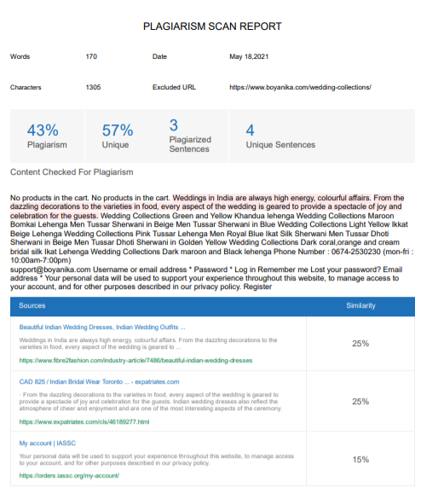
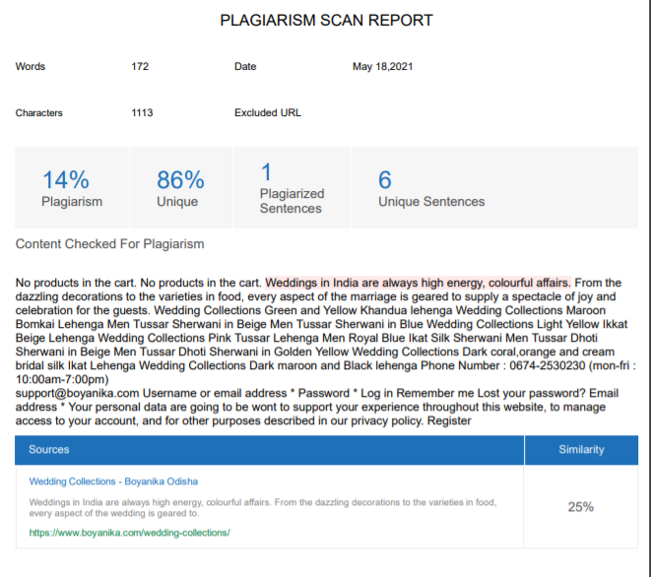
SEO Audit
plagiarized
Content Insights
Plagiarism
As we can see the plagiarism % is quite high.
I would suggest rewriting these plagiarized
lines.
Not Plagiarized

Slide 3
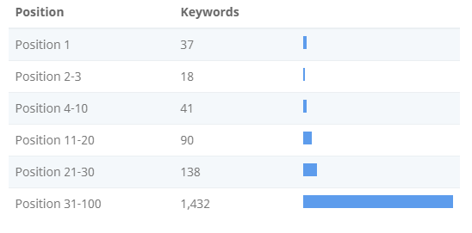
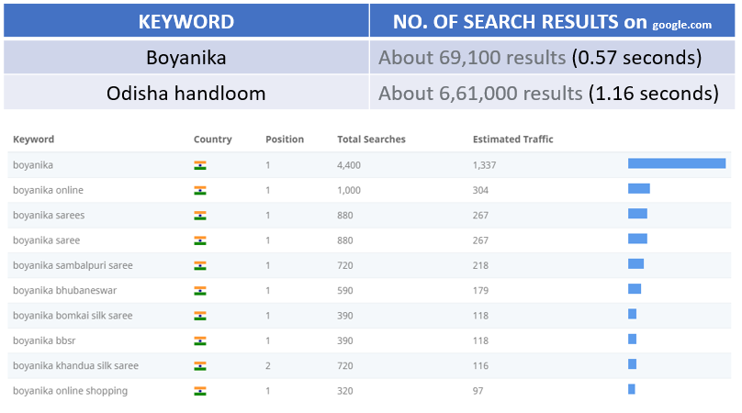
Keyword Presence
This shows you a summary of the positions for site’s Keyword Rankings.
Local Search results in US show that about 200 times monthly for the keywords (Boyanika , Boyanika sarees, Boyanika Bhubaneswar online.)
Search results in India are rather high and this site has pretty no. of high/top position keywords.

Slide 4
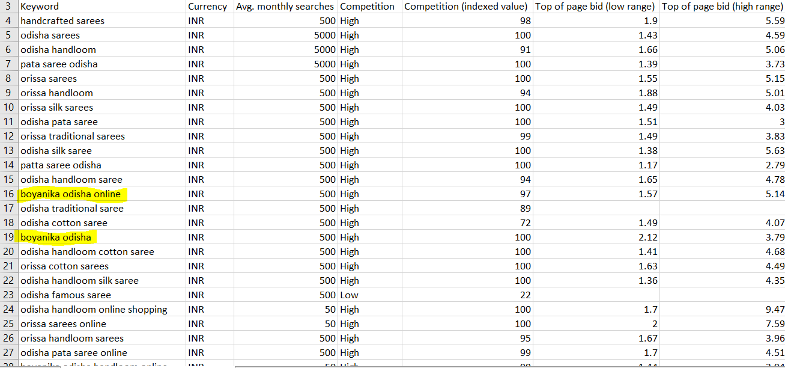
Keyword Presence
Out of all keywords , few keywords are top positioned while many keywords (1432 approx.) are low position and are rarely used by users .
These are some of recommended keywords gathered from google ads (keyword planning Tool).

Slide 5
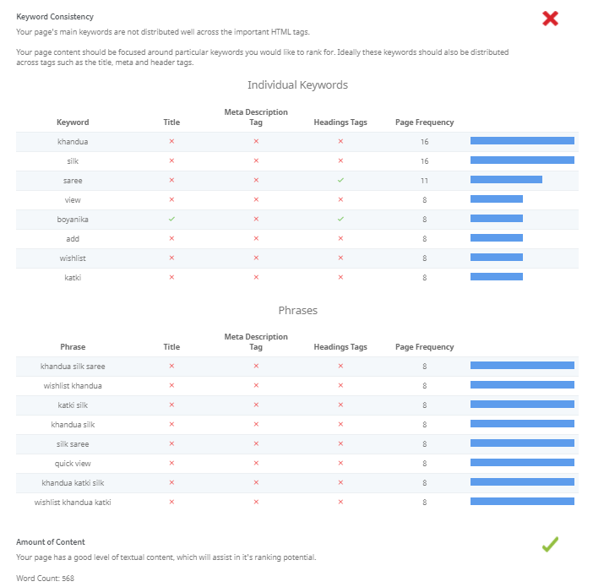
Keyword Presence
This site does contain some clusters and there is sight of keyword stuffing.
From the results on Seoptimer , we found out some of the keywords were missing title tags, meta description tags and h2 headings.

Slide 6
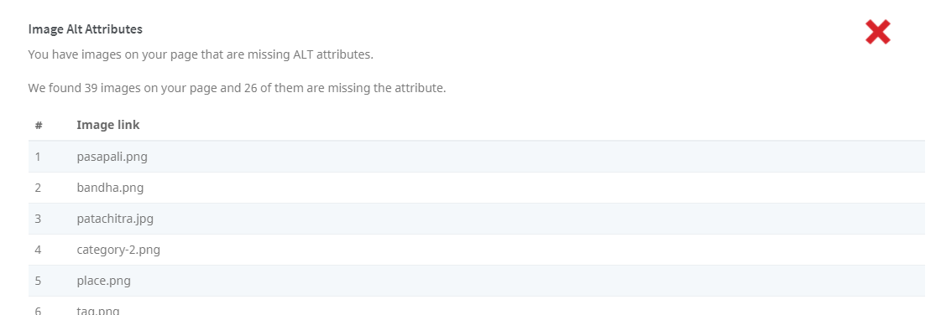
Keyword Presence
Alt Texts Errors: Total of 39 images were found missing alt attributes.
Robots

Slide 7
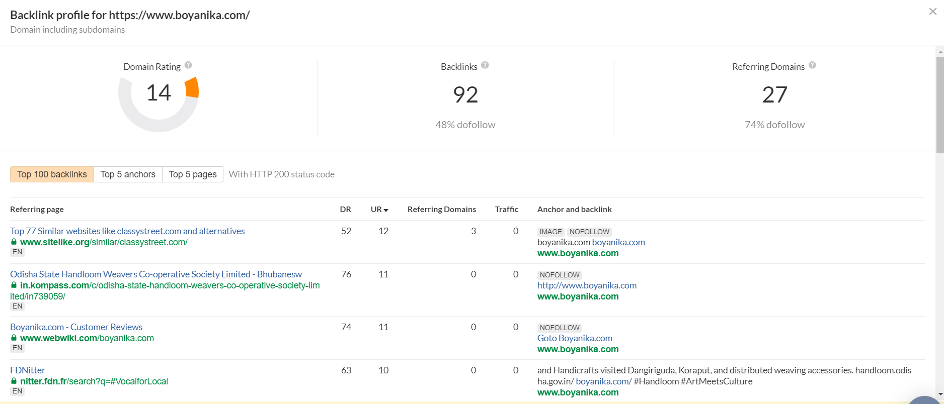
Keyword Presence
BACKLINKS

Slide 8
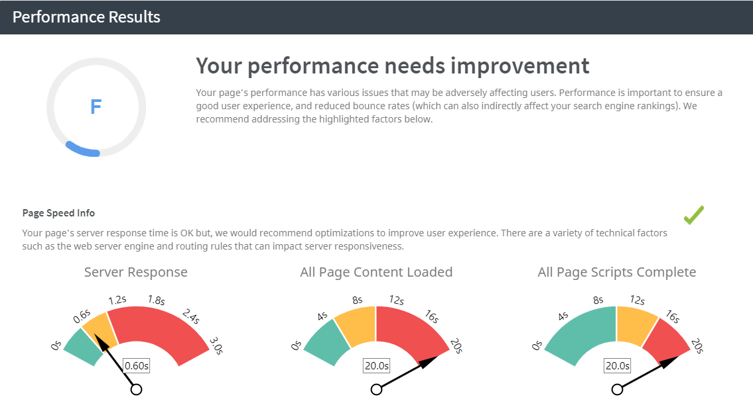
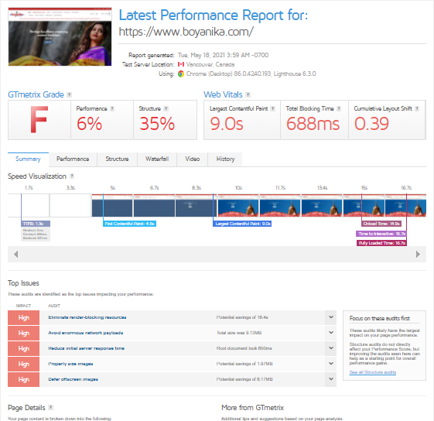
SEO Audit
Website Load Performance
The site took approx. 15.7 secs to fully load considering the size and image content of the pages ,it is highly recommended for optimization.
Seoptimer also showed similar results.

Slide 9
SEO Audit
Broken Links
There were 3 broken links found.

